Slide 1


OOPC MINI-PROJECT
VIRTUAL CLASSROOM
MADE BY:-
YASH PANELIYA -18DCS058
JIGNESH KUKADIYA -18DCS037
UTKARSH KARNIK-18DCS034
UDIT KAMDAR-18DCS032

Slide 2
Introduction
Virtual classroom is basically a way of communication which can be done from anywhere and can be accessed by different people.
It helps in connectivity of people.
In this project, we tried to connect students and teachers where they can access their different purpose.

Slide 3
Motivation
In this era , people wish to live a comfort way of living and technology has fulfilled this a lot better.
This motivate us to create virtual classroom which can connect teachers and students to their respective field.
By doing this , students can access their subject related topics and can also do quiz which helps them to improve their study and teacher can take attendance online.

Slide 4
Applications
This project can be used in different schools and universities to mark and see attendance of students, get study materials and practice test by students.
It is also useful as it helps in distant learning program.

Slide 5
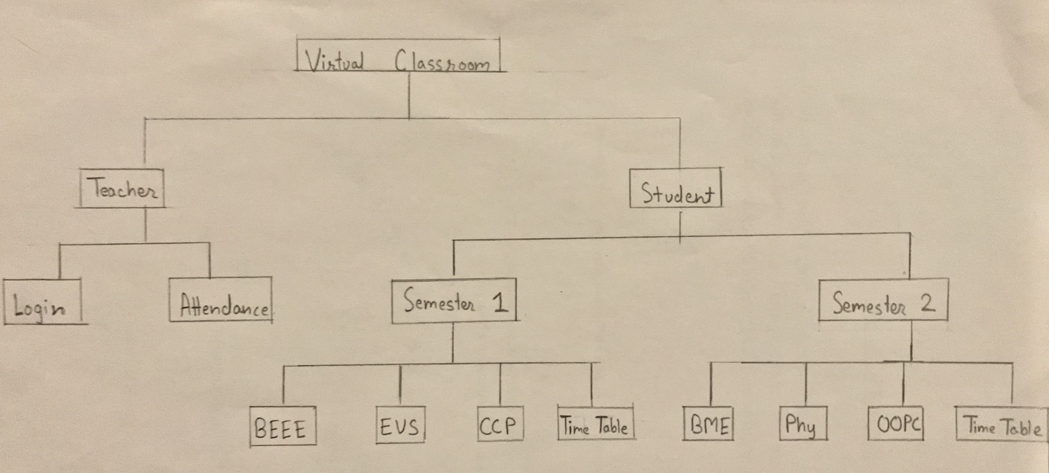
FLOWCHART

Slide 6
Challenges
It was difficult for us to merge different individual class into single large program as it gives us scope resolution and declaration syntax error.
In login signup class,there was a difficulty as it was giving output of every individual user instead of desired single user.
Password hiding was also difficult task to solve.
It was also difficult for us to go to from chapter page to main page[subject list].

Slide 7
Minimum configuration
Software:
Code::Blocks [12.11/13.12/16.01/17.12]
Turbo c++
Hardware:
PC
Minimum RAM 1GB

Slide 8
Future Scope
In this project, we can also add video and audio of related subject so that students can understand better.
We can also add timetable in this program.
Video conferencing between teacher and student can also be done.

Slide 9
Conclusion
By this project, we came to know how to make a real life Application through C++ language. By doing this project we learnt various concepts of C++ such as file handling ,classes and objects inheritance.

Slide 10
References
https://www.Wikipedia.org
https://youtu.be/TF2-F2duY6c
https://www.elcetronics-tutorials.ws
https://www.geeksforgeeks.org

Slide 11
THANK YOU!!

